Slide 1
PHP with MySQL 1

Slide 2
Basic PHP MySQL functions
Connecting to a Database
Selecting a database
Running a query
Using results of a query
Closing the connection
Original functions start with mysql_
Improved version from php5 starts with mysqli_

Slide 3
Database Connection
mysqli_connect(server, username, password)
server default is the string "localhost"
username is a string for the user name ("labuser")
password is a string for the password ("macimd15")
e.g. For Mac lab
$conn= mysqli_connect("localhost", "labuser", "macimd15");
For Windows Labs
$conn= mysqli_connect("localhost", "labuser", "Labuser1");
For WAMP/MAMP/XAMPP with default password
$conn= mysqli_connect("localhost", "root", "");

Slide 4
Sample Connection Code
<?php
$conn = mysqli_connect("localhost", "labuser", "macimd15")
or die("Could not connect: " . mysqli_error($conn));
print "Successful Connection";
mysqli_close($conn);
?>

Slide 5
Selecting a database
mysqli_select_db(connection , name)
select a database given by the string name
The connection variable is required
e.g.
mysqli_select_db($conn, "labuser");

Slide 6
Connect & Select database code
<?php
$conn = mysqli_connect('localhost', 'labuser', 'macimd15')
or die ('No connection : ' . mysqli_error($conn));
mysqli_select_db($conn , 'labuser') or die ('db will not open' . mysqli_error($conn));
print "Database Connected";
mysqli_close($conn);
?>

Slide 7
Error Messages
mysqli_error(connection)
Returns an error string or error number (connection is optional - with last opened connection used if none supplied)
Empty string is returned if there is no error.
Example
mysqli_error($conn);

Slide 8
Making A Query
mysqli_query(connection , query)
makes a select query
query is a string for the MySQL query (in SQL)
semicolon (;)should NOT be used to terminate query
query uses valid SQL command
e.g.
$query = "SELECT surname FROM student";
$result = mysqli_query($conn, $query);

Slide 9
Connect, Select db & query
<?php
$conn = mysqli_connect('localhost', 'labuser', 'macimd15')
or die ('No connection');
mysqli_select_db($conn ,'labuser') or die ('db will not open');
$query = "SELECT surname FROM student";
$result = mysqli_query($conn, $query) or die("Invalid query");
print "Successful Query";
mysqli_close($conn);
?>

Slide 10
Closing a connection
mysqli_close(connection)
closes the database connection with the link
e.g.
mysqli_close($conn);
mysqli_free_result(result)
frees up memory during a program
mysqli_free_result($result);

Slide 11
Other mysql Functions (1)
mysqli_num_rows(result)
returns number of rows from a select query
mysqli_fetch_row(result)
each call returns the next row as an indexed array
e.g.
$result = mysqli_query($conn, "select * from module");
$num = mysqli_num_rows($result);
for($i=1; $i<=$num; $i++)
{
$row = mysqli_fetch_row($result);
echo $row[0] . " " . $row[1];
}

Slide 12
Other mysql Functions (2)
mysqli_affected_rows($conn)
used after an INSERT, UPDATE, or DELETE query to return the number of rows affected
mysqli_free_result(result)
frees memory within a php program

Slide 13
Other mysql Functions (3)
mysqli_num_fields(result)
returns the name of the table column whose position is given by index (0,1,...)
e.g.
$res = mysqli_query($conn, 'select * from module');
$numfields = mysqli_num_fields($res);
echo "number of fields in module is " . $numfields;

Slide 14
Other mysql Functions (4)
mysqli_fetch_array(result)
returns row information as an array
e.g.
$result = mysqli_query($conn, "select * from module");
while($row = mysqli_fetch_array($result))
{
echo $row['modulecode'] . " " . $row['modulename'];
}
Function returns TRUE while a row is fetched & FALSE when there are no rows available
Function will fetch an array as associative or sequential

Slide 15
Sample Code 1
<?php
$conn = mysqli_connect('localhost', 'root', '') or die ('No connection');
mysqli_select_db($conn, 'projemp') or die ('DB will not open');
$query = "SELECT eno, ename, salary from emp order by ename asc";
$result = mysqli_query($conn, $query) or die("Invalid query");
$num = mysqli_num_rows($result);
echo "<table border='1'><tr><th>eno</th><th>ename</th>
<th>salary</th></tr>";
for($i=0; $i<$num; $i++) {
$row = mysqli_fetch_row($result);
echo "<tr><td>" . $row[0] . "</td><td>" . $row[1];
echo "</td><td>" . $row[2] . "</td></tr>";
}
echo "</table>";
mysqli_close($conn);
?>

Slide 16
For Loop
//counts number of rows in $result
$num = mysqli_num_rows($result);
for($i=0; $i<$num; $i++) { // goes round once for each row
$row = mysqli_fetch_row($result);
// puts next row into $row array
echo "<tr><td>" . $row[0] . "</td><td>" . $row[1];
echo "</td><td>" . $row[2] . "</td></tr>";
} // prints the first, second & third column of the current row
// as sequential array values … 0,1,2

Slide 17
Sample Code 2
<?php
$conn = mysqli_connect('localhost', 'root', '') or die ('No connection');
mysqli_select_db($conn,'projemp') or die (' DB will not open');
$query = "SELECT eno, ename, salary from emp order by ename desc";
$result = mysqli_query($conn, $query) or die('Invalid query');
echo "<table border='1'><tr><th>eno</th><th>ename</th>
<th>salary</th></tr>";
while($row = mysqli_fetch_array($result))
{
echo "<tr><td>" . $row['eno'] . "</td><td>" . $row['ename'];
echo "</td><td>" . $row['salary'] . "</td></tr>";
}
echo "</table>";
mysqli_close($conn);
?>

Slide 18
While Loop
// while there is a new row to fetch
while($row = mysqli_fetch_array($result))
{
echo "<tr><td>" . $row['eno'] . "</td><td>" . $row['ename'];
echo "</td><td>" . $row['salary'] . "</td></tr>";
} // print the columns using associative array index values
// 'eno', 'ename' & 'salary'

Slide 19
Next Step
Having connected to mysql (mysqli_connect)
Selected a database (mysqli_select_db)
Run a query (mysqli_query)
Process the result (mysqli_fetch_row,
mysqli_fetch_array)
Generalise the select query
  Get selection clause value from the user (textbox, or even better, a drop down box in html form)

Slide 20
Adding variable to a query string
$value=$_POST["valuelist"];
$query = "SELECT * from emp where salary > " . $value;
[Whatever value is entered in the html front end is posted and plugged into the query string]
Where the where clause uses a text attribute inverted commas must be placed round the value
e.g. SELECT * FROM emp WHERE ename = 'smith'
$query = "SELECT * from emp where ename = ‘ $value'";
[Note the single quotes placed round the variable]

Slide 21
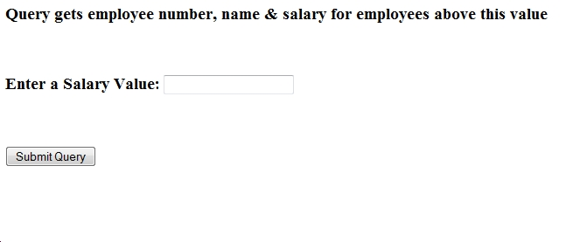
Generalised Query 1

Slide 22
Text Box
In an html form:
Enter a salary value: <input type = "text" name = "textvalue">
Backend php file dbconnect1.php:
<?php
$sal = $_POST["textvalue"];
………………………….
$query = "SELECT * from emp where salary > " . $sal;

Slide 23
dbconnect1.php
<?php
$sal=$_POST["textvalue"]; // receives posted value entered in textbox called textvalue
$conn = mysqli_connect('localhost', 'labuser', 'macimd15') or die ('No connection');
mysqli_select_db($conn, 'labuser') or die (' test will not open');
$query = "SELECT eno, ename, salary from emp where salary > " . $sal;
$result = mysqli_query($conn, $query) or die("Invalid query");
echo "<table border='1'><tr><th>eno</th><th>ename</th><th>salary</th></tr>";
while ($row = mysqli_fetch_row($result)) {
echo "<tr><td>" . $row[0] . "</td><td>" . $row[1];
echo "</td><td>" . $row[2] . "</td></tr>";
}
echo "</table>";
mysqli_close($conn);
?>

Slide 24
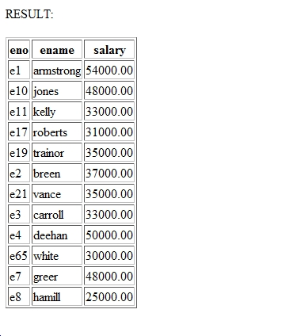
Generalised Query 1 output

Slide 25
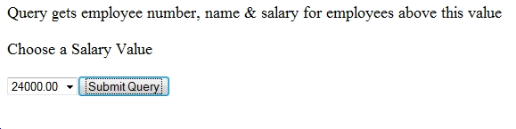
Generalised Query 2

Slide 26
Select Box
In an html form:
<select name="valuelist">
<option value="24000">24000</option>
<option value="28000">28000</option>
<option value="32000">32000</option>
</select>
Chosen valuelist option value posted to backend php file (dbconnect2.php)
$sal = $_POST["valuelist"];
$query = "SELECT * from emp where salary > " . $sal;

Slide 27
dbconnect2.php
<?php
$sal = $_POST["valuelist"]; // receives posted value option from selectbox valuelist
$conn = mysqli_connect('localhost', 'labuser', 'macimd15') or die ('No connection');
mysqli_select_db($conn, 'labuser') or die (' test will not open');
$query = "SELECT eno, ename, salary from emp where salary > " . $sal;
$result = mysqli_query($conn, $query) or die("Invalid query");
echo "<table border='1'><tr><th>eno</th><th>ename</th><th>salary</th></tr>";
while ($row = mysqli_fetch_row($result)) {
echo "<tr><td>" . $row[0] . "</td><td>" . $row[1];
echo "</td><td>" . $row[2] . "</td></tr>";
}
echo "</table>";
mysqli_close($conn);
?>

Slide 28
Summary
Connect to MySQL server
connection = mysqli_connect(server, username, password)
Select a database
mysqli_select_db(connection, databasename)
Run a query
result = mysqli_query(connection, query)
Process query
mysqli_fetch_row(result)
mysqli_fetch_array(result)
Close connection
mysqli_close(connection)

